Slide 1
Multiple Literacies in Project-Based Learning Moving Forward and Our Efficacy Study
Joe Krajcik & Sue Codere
MiSciPLN
April 16, 2021
Notes:
Joe

Slide 2
ML-PBL Development and Research Teams
A collaboration among teachers and researchers with multiple expertise
for Grades 3-5
Emily Miller, Deborah Peek-Brown, Susan Codere, Barbara Schneider, I-Chien Chen, Quinton Baker, Lydia Bradford, Cory Miller, Kayla Bratz, Tingting Li, Selin Akgun, Kayla Bartz, Kelli Finnie, Sam Richar, Joe Krajcik
Annemarie Palincsar, Elliot Soloway, Miranda Fitzgerald, Meredith Baker Marcum, Josh Meyer, Kathleen Easley, Gabriel Dellavecchia
Many thanks to our teachers in Michigan and Wisconsin who provided insights in using ML-PBL in classrooms
A special thanks to regional leaders for their support and belief in ML-PBL: James Emmerling – Genesee ISD/Oakland Schools, Kristie Ford - Detroit Public Schools Community District, and Wendi Vogel - Kent ISD
Funded by Lucas
Education Research Foundation
Notes:
Joe

Slide 3
Purpose of ML-PBL
Multiple Literacies in Project-Based Learning
Design, develop and test a system for advancing science teaching and learning that builds a vision for enacting project-based learning and meeting NGSS for 3rd - 5th grade. The system includes:
Highly developed and specified educative teacher materials
Highly developed and specified student materials
Extended professional learning supports
3-dimensional formative and end-of-unit assessments
Engage all students in sensemaking
Use language literacy and mathematical tools to develop usable science knowledge
Conduct an efficacy study for the 3rd-grade materials
Notes:
Joe

Slide 4
Features of Project-Based Learning
Pursue solution to a meaningful question (Driving Question).
Use big ideas to frame 3-D learning goals.
Explore the question by participating in scientific practices to “figure out” why phenomena occurs and learn important ideas in the discipline.
Engage in collaborative activities to find solutions.
Use learning technologies and other scaffolds to help students participate in activities normally beyond their ability.
Create artifacts – tangible products – that address the driving question and represent student knowledge.

Slide 5
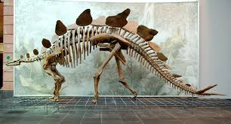
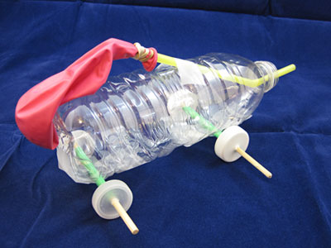
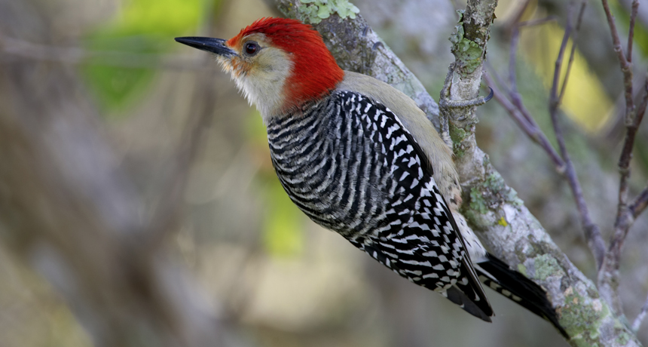
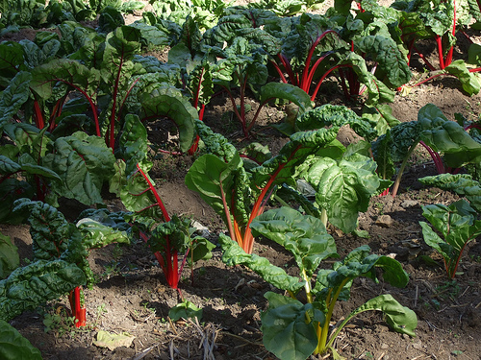
Grade 3 Overview
Why do we see so many squirrels but can’t find any Stegosauruses?Energy and
Structure of Traits
Designing for Structure
Function of Traits
Designing for Function
Structure and Function as the Crosscutting Concept
Developing Models as the Scientific Practice
Developing Claims with Evidence as Scientific Practice
Notes:
… as the CCC focus … as the Practice focus ???

Slide 6
Grade 3 Overview
Driving Questions | Major Big Ideas
Why do I see so many squirrels but I can’t find any stegosauruses? | Animal Adaptations/ Survival/Climate
How can we design fun moving toys that other kids can build? | Force and Motion Engineering Design
How can we help the birds near our school grow up and thrive? | Plant and Animal Adaptations/ Natural Selection/ Biodiversity
How can we plan gardens for our community to grow plants for food? | Weather and Climate/ Growing Plants for Food
Coherence – All Grade-Level NGSS PEs
Notes:
See Grade 3 Unit Summaries

Slide 7
ML-PBL – A Systems Model of Change
System Components
Features of Project-based Learning
Three Dimensions of Scientific Knowledge to Make Sense of Phenomena
Highly Specified and Developed Teacher and Student Materials
Performance-Based Assessments
Sustained Professional Learning
Rachel Marias
Grad Student
Ellie Paulson
Undergrad

Slide 8
CESE & ML-PBL
System Model
Project-based Learning Principle
Driving Question
Exploring and Explaining Phenomena
Artifact Development
Collaboration/Discourse
Community Connections
Equity
PBL - a Systems Approach
Teacher and Student
Materials
Professional Learning
Assessment
Outcomes
Academic and Social
and Emotional
Learning
Enjoyment
Curiosity
Ownership
Engagement: Teacher and Students
Challenge, Interest and Competency
Learning Context
Face-to-Face
Virtual
Hybrid
3-Dimensional Instruction
Integrating Disciplinary Core Ideas, Scientific Practices, Crosscutting Concepts

Slide 9
The
In ML-PBL the “figuring out” process, driven by phenomena, creates optimal learning moments
Students experience a phenomenon
This raises questions
This leads to using scientific practices
They figure out some new things (and develop new questions)
Events in nature
that we can observe,
investigate
and then try to explain
Investigating,
developing models, constructing explanations,
analyzing data,
designing solutions,
Using mathematical thinking etc.
Students ask their own questions
Students develop new ideas to help them explain phenomena and ask new questions..
Notes:
It is the phenomena and question that drove the figuring out process - How 3D learning and PBL work together.
Thanks to Ted Willard from NSTA

Slide 10
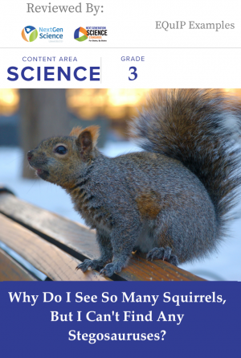
NGSS Design Badge
The Grade 3 unit is available as a free open education resource. The following link will direct you to sign up and request access to the Squirrels Unit Page on the Lucas Education Research webpage:
Why Do I See So Many Squirrels, but I Can't Find Any Stegosauruses?
NGSS Design Badge
https://www.nextgenscience.org/resources/grade-3-why-do-i-see-so-many-squirrels-i-cant-find-any-stegosauruses
Awarded: Aug 25, 2020
Awarded To: Why Do I See So Many Squirrels, but I Can't Find Any Stegosauruses?

Slide 11
Professional Learning Program
Professional Learning
Treatment
3 days in August; 3 additional days during the school year (one-day introduction to each subsequent unit)
Video conference sessions during each unit
Control
One introductory session to NGSS and expectations for participation as control (survey, assessment, class list, etc.)

Slide 12
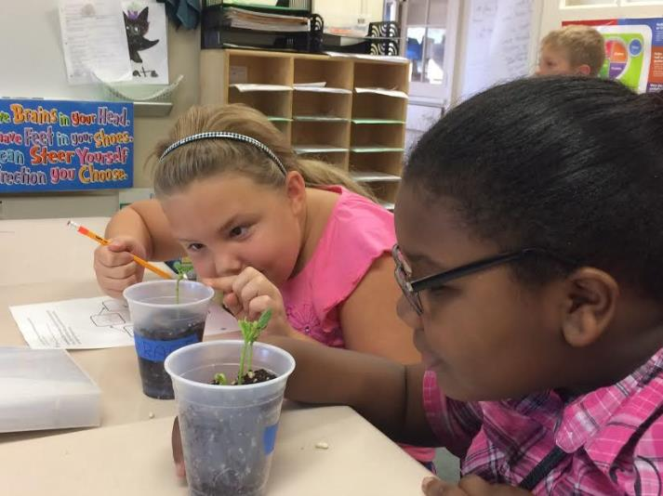
ML-PBL Development and Research Plan
Developing, Testing and Revising Cycle
Teaching Experiments
Pilot Studies
Field Studies
Efficacy Study
Maturation Study

Slide 13
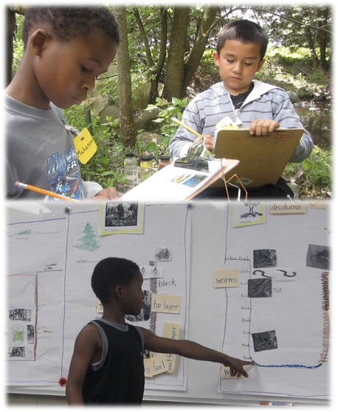
Our Efficacy Study
Research Sites
Sample Characteristics
Main Effect
SEL Impact
Notes:
Joe

Slide 14
Research Study Sites
46 Schools in study
23 Treatment
23 Control
83 Teachers
37 Treatment
46 Control
2,019 Students
944 Treatment
1,075 Control
Treatment
Control
Notes:
I-Chien https://drive.google.com/open?id=1CoD91DVXen0qZtYgd59moquYnj-vCf4x&usp=sharing
Conduct efficacy study
Randomization

Slide 15
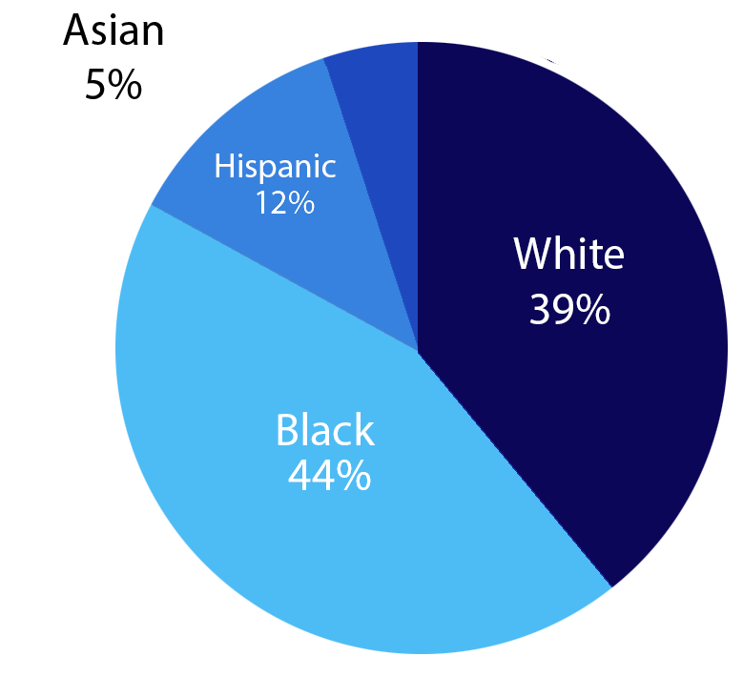
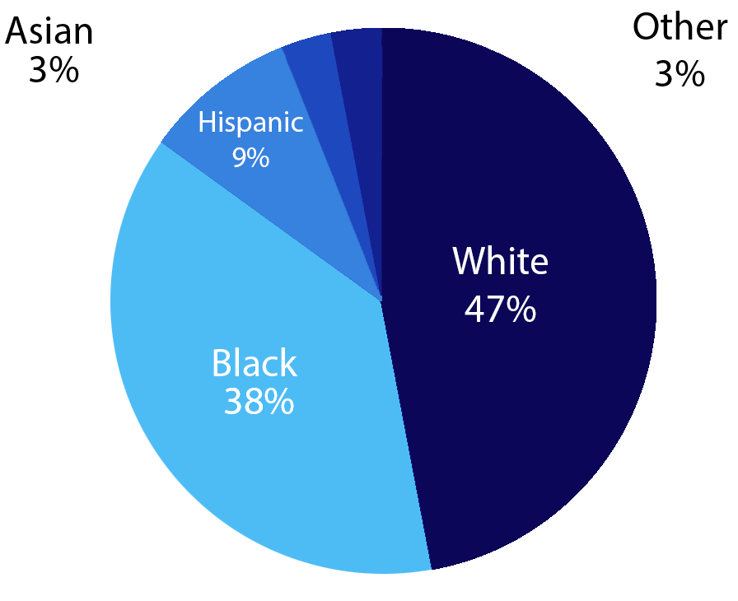
Student Race/Ethnicity
Control
Treatment
Notes:
I-Chien
baseline data equivalence check

Slide 16
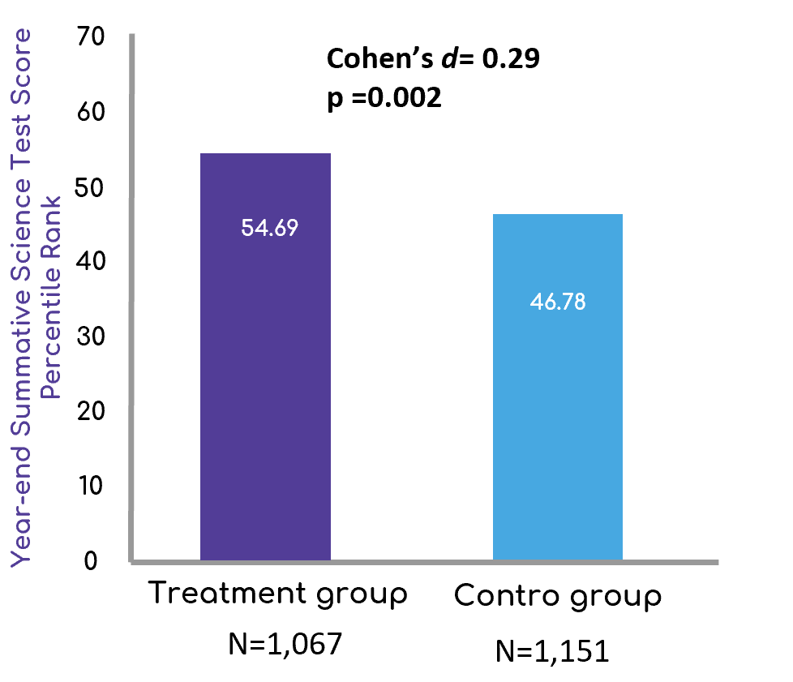
Findings
Efficacy study (2018-2019): Randomize Controlled Trial design.
46 Schools (23 Control + 23 Treatment); 89 Teachers; 2,218 students
Effect size = .29, which accounted for 8% increase (generalizable to the state and the nation).
These results are consistent across gender, race, ethnicity and reading ability.

Slide 17
Impact on Science Learning Based on
Reading Skill Level
70
68.47
60
61.38
63.65
Control
Treatment
50
51.32
50.20
49.37
40
43.06
41.79
41.84
Science Test Score Percentile Rank
30
34.19
20
10
*p= 0.002
0
Poor*
Below Average*
Average*
Above Average*
Excellent*
Reading Skill Level
Notes:
Quinton

Slide 18
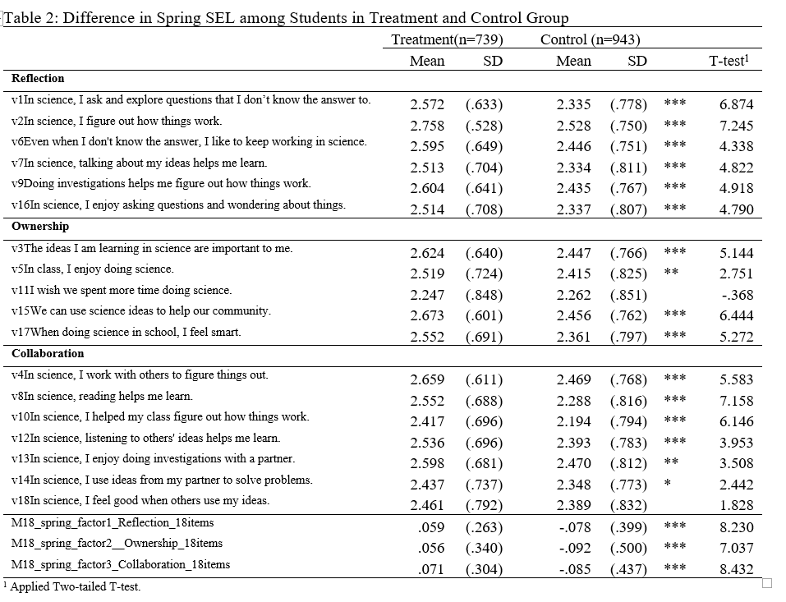
Significant Growth Across All Three Social And Emotional Learning Constructs
Notes:
I-Chien

Slide 19
Case Study Work
The value of case study research in RCTs
Cases were constructed with the use of multiple data sources (including: transcribed video, observational data, classroom and student artifacts, interviews)
Cases foreground particular features of ML-PBL (e.g., role of the driving question in sensemaking discussions, transformation of teacher practice over time, integration of language literacy and technology in ML-PBL instruction)
We engaged in an iterative process of constructing, sharing, and revising the cases, as a team
Notes:
Annemarie

Slide 20
Case Studies
A series of Case Studies that document teachers use of the ML-PBL features will be published by Harvard Educational Press in September 2021.
Book title: Science Education Through Multiple Literacies: Project-Based Learning in Elementary School
J Serba, 3rd Grade Lewiston, in Yr 1, transitioned to full integration of science and literacy

Slide 21
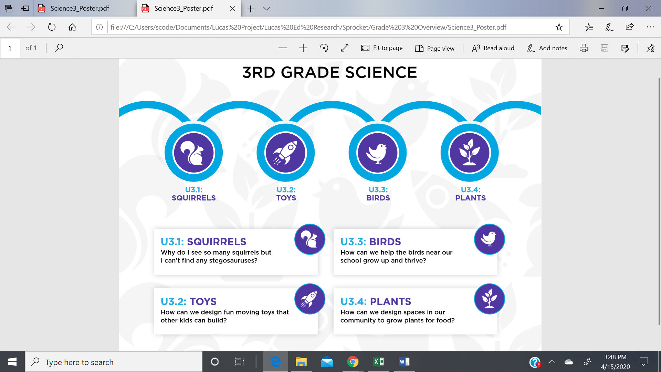
Sprocket
ML-PBL 3rd Grade Science on Sprocket
Request Access http://sprocket.lucasedresearch.org/mlpbl
Notes:
Sue

Slide 22
ML-PBL Resources
Access or Download the ML-PBL resources at Sprocket
https://sprocket.lucasedresearch.org/

Slide 23
Professional Learning
Next Generation – PBL from CREATE for STEM provides professional learning for a fee.
Next Gen – PBL is creating K – 2 materials that follow the design model of ML-PBL
Learn more about them at https://learn.open3d.science/
Contact Chris Reimann @ reimannc@msu.edu

Slide 24
Learn more about ML-PBL
Edutopia video that summarizes today session
https://www.edutopia.org/video/project-based-approach-teaching-elementary-science
Visit our web site: https://mlpbl.open3d.science/curriculum

Slide 25
Take Aways
Evidence supports that ML-PBL can work in elementary classrooms to improve academic learning and SEL of children from various reading levels and backgrounds and that teachers can use challenging materials that engage children in doing science.
Our work has been vetted by academic journals, Harvard University Presses, and is still currently under review.
The ideas of three-dimensional learning (DCIs, SEPs, CCs) are critical for principled, PBL based science reforms.
Science needs to take a place equal to reading and mathematics in K-12 Education
The work would not have been possible without the dedication and contributions of many.
We continue to study how to promote engagement and deep learning in elementary classrooms
More work needs to be done to sustain and spread ML-PBL.
Notes:
Joe

Slide 26
Questions for Team
Questions? Comments?
Contact information
Joe: krajcik@msu.edu,
tweeter - @krajcikjoe
Sue: scodere@gmail.com

