Slide 1

Characterizing and Evaluating Engagement in Scientific Practices in the Chemistry Laboratory
Justin H. Carmel
Department of Chemistry and Biochemistry
STEM Transformation Institute
Notes:
Transformations that have been made, Focus on Framework, how it’s important past K12,

Slide 2


Laboratory Learning
1982
More research needed on effects of laboratory learning
2000
Little evidence traditional labs reinforce science understanding/recall
2012
Focus on outcomes of lab instruction; change in gateway courses
Hofstein, A.; Lunetta, V.N.; (1982). Review of Educational Research, 52(2), 201-217
Hart, C. et al.; (2000). Journal of Research in Science Teaching,37(7), 655-675.
Herrington, D.G.; Nakhleh, M.B.; (2003), Journal of Chemical Education, 80(10), 1197-1205.
Hofstein, A.; Lunetta, V.N.; (2004). Science Education, 88(1), 28-54.
National Research Council. (2012). DBER: Understanding and improving learning in undergraduate science & engineering. pp. 130-140.
PCAST (2012). Engage to excel: Producing one million additional college graduates with degrees in STEM
Notes:
In 1982, Hofstein and Lunetta reported on the state of affairs as it pertained to learning in the chemistry laboratory. creative thinking, problem solving and critical thinking. more research needed on things like student behavior, intellectual development, skill levels, affective domain (interest, curiosity)
Around 2000, more research had been done regarding labs, however few if any studies provided any evidence that the traditional laboratory activities were affecting science understanding and retention
The DBER and PCAST reports in the early 2010s focused on the outcomes of lab, restating that traditional labs were still not working, as well as a call for change of our large enrollment gateway courses.

Slide 3
What is the purpose of lab?
Chemistry Content
Laboratory Techniques
Problem Solving Skills/ Troubleshooting
Teaching students how to act like a scientist!
Elliott, M. J.; Stewart, K. K.; Lagowski, J. J. (2008). Journal of Chemical Education, 85(1), 145-149.
Notes:
Problem solving: designing a solution to a given scenario or problem

Slide 4

National Research Council. (2012). A Framework for K-12 Science Education: Practices, Crosscutting Concepts, and Core Ideas. Washington DC: The National Academies Press.
Notes:
Cover from framework document (document helped try to address these issues in K-12 and now we are trying to expand these ideas into the college level)

Slide 5

…what we want students to do with that knowledge...
...and lenses they can use to think about knowledge across disciplines.
What we want students to know...
National Research Council. (2012). A Framework for K-12 Science Education: Practices, Crosscutting Concepts, and Core Ideas. Washington DC: The National Academies Press.
Cooper, M.M. (2020). Journal of Chemical Education, 97(4), 903-909.

Slide 6
Scientific and Engineering Practices
  The multiple ways of knowing and doing that scientists and engineers use to study the natural world and design world.
Asking questions and defining problems
Developing and using models
Planning and carrying out investigations
Analyzing and interpreting data
Using math and computational thinking
Constructing explanations and designing solutions
Engaging in argument from evidence
Obtaining, evaluating and communicating information
National Research Council. (2012). A Framework for K-12 Science Education: Practices, Crosscutting Concepts, and Core Ideas. Washington DC: The National Academies Press.
Laverty et al. (2016). PLoS ONE 11(9): e0162333. doi:10.1371/journal.pone.0162333
Notes:
Built from the ideas of
6

Slide 7
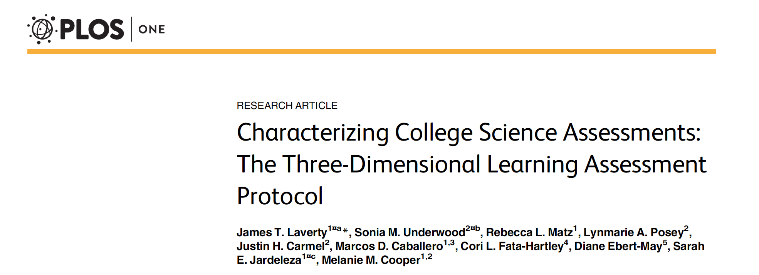
Laverty et al. (2016). PLoS ONE 11(9): e0162333. doi:10.1371/journal.pone.0162333

Slide 8
The 3D-LAP
Scientific Practices
Crosscutting Concepts
Core Ideas
Is there a crosscutting concept? If so, which one(s)?
Is there a core idea? If so, which one(s)?
Is there a practice? If so, which one(s)?
Laverty et al. (2016). PLoS ONE 11(9): e0162333. doi:10.1371/journal.pone.0162333

Slide 9
Example Criteria: Argumentation
Question gives an event, observation, or phenomenon.
Question gives or asks student to select a claim based on the given event, observation, or phenomenon.
Question asks student to select evidence to support their claim in the form of data or observations.
Question asks student to select the causal reasoning linking the evidence to the claim using one or more scientific principles.
Laverty et al. (2016). PLoS ONE 11(9): e0162333. doi:10.1371/journal.pone.0162333
Notes:
Add an example of this! Maybe one that is missing reasoning.

Slide 10
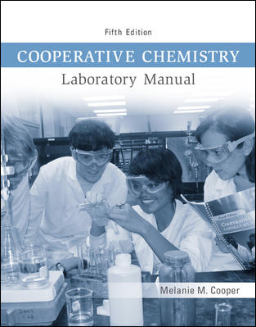
A Different Curriculum
Multi-week group projects, designing procedures, enacting procedures
Improvement in metacognition, problem solving
Sandi-Urena, S.; Cooper, M. M.; Gatlin, T. A.; Bhattacharyya, G. (2011). Chemistry Education Research & Practice, 12, 434-442.
Cooper, M. M. (2012). Cooperative Chemistry Laboratory Manual (5th ed.). McGraw-Hill Publishing: New York, NY.
Cooper, M. M.; Sandi-Urena, S. (2013). Trajectories in Chemistry Education and Reform. American Chemical Society.
Notes:
So by adopting the CC projects

Slide 11
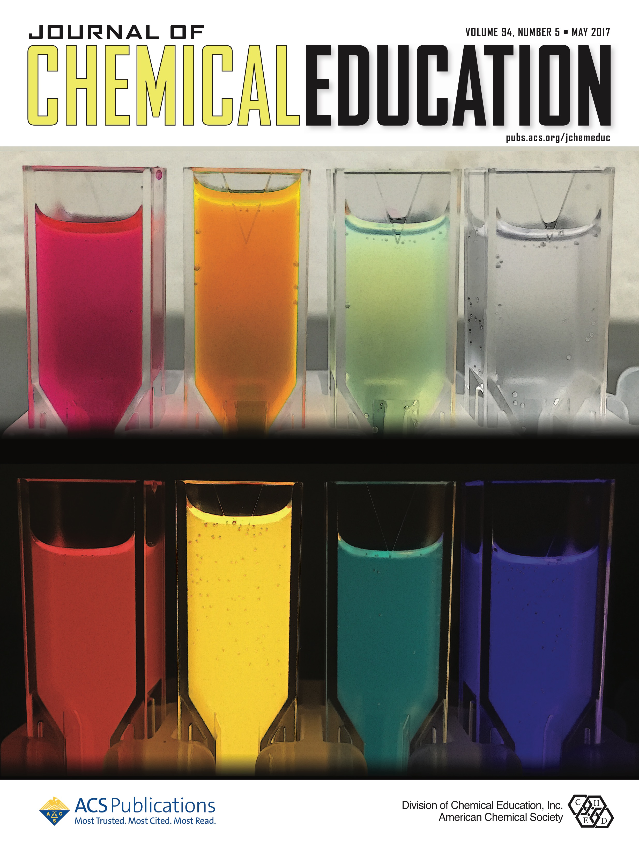
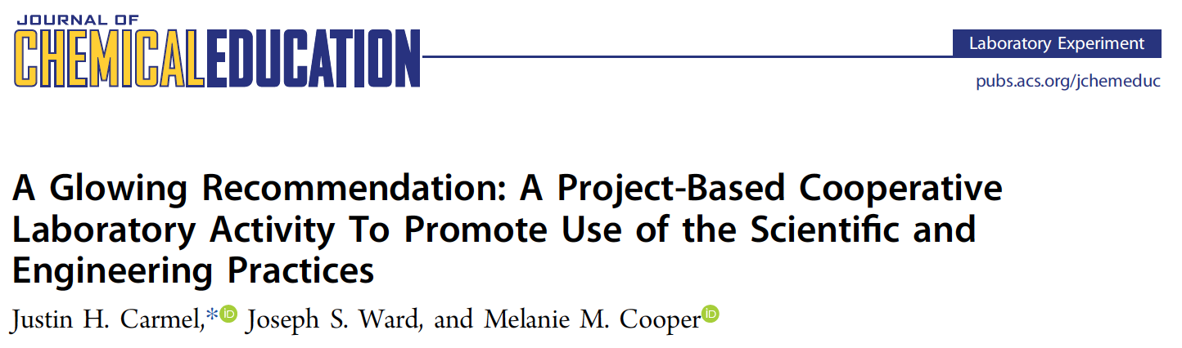
Carmel, J.H., Ward, J.S., & Cooper, M.M. (2017). Journal of Chemical Education, 94(5), 626-631.

Slide 12
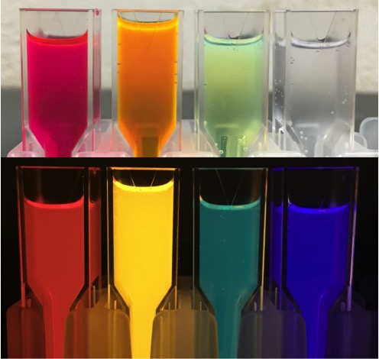
A customer has approached the company and has asked for two specific types of glow-sticks: 1) one that provides a very intense glow for approximately a minute and 2) one that has a novel color and lasts as long as possible.
Make a table of the amounts of reagents and reaction conditions for the two reaction systems that address the customer’s requests.
1) What is the reason for having different dye solutions in the reaction system?
2) What is the effect of varying the ratio of two different dye solutions?
3) What caused the reaction to go faster? What caused the reaction to go slower?
Ask Questions/ Define Problems | Develop/Use Models | Plan/Carry Out Investigations | Analyze/ Interpret Data | Use Math/ Computational Thinking | Construct Explanations & Engage in Argument from Evidence | Design Solutions | Obtain & Evaluate Information | Communicate Information
Write a preliminary plan for your experimental procedures that includes everything your team must do to carry out your reaction protocols. Indicate what each person in your group will do to solve the problem and what data they will record. Remember, everyone should be doing chemistry!
Using your answers to the Project Summary Questions, construct an evidence-centered argument about the effect of temperature on the Cyalume reaction system.
What is your claim?
What is the evidence that supports your claim? Why/how does your evidence support your claim?
Now explain using scientific principles the reasoning behind why temperature affects the reaction system in this way.
Carmel, J.H., Ward, J.S., & Cooper, M.M. (2017). Journal of Chemical Education, 94(5), 626-631.

Slide 13
Project 1: Gas Temperature-Volume Relationship
Ask Questions/ Define Problems | Develop/Use Models | Plan/Carry Out Investigations | Analyze/ Interpret Data | Use Math/ Computational Thinking | Construct Explanations & Engage in Argumentation from Evidence | Design Solutions | Obtain & Evaluate Information | Communicate Information
Project 2: A Glowing Recommendation
Ask Questions/ Define Problems | Develop/Use Models | Plan/Carry Out Investigations | Analyze/ Interpret Data | Use Math/ Computational Thinking | Construct Explanations & Engage in Argumentation from Evidence | Design Solutions | Obtain & Evaluate Information | Communicate Information
Project 3: Identification and Synthesis of an Unknown Ionic Compound
Ask Questions/ Define Problems | Develop/Use Models | Plan/Carry Out Investigations | Analyze/ Interpret Data | Use Math/ Computational Thinking | Construct Explanations & Engage in Argumentation from Evidence | Design Solutions | Obtain & Evaluate Information | Communicate Information
Project 4: Food Dye Spectroscopy
Ask Questions/ Define Problems | Develop/Use Models | Plan/Carry Out Investigations | Analyze/ Interpret Data | Use Math/ Computational Thinking | Construct Explanations & Engage in Argumentation from Evidence | Design Solutions | Obtain & Evaluate Information | Communicate Information
Project 5: Polymer Identification and Separation
Ask Questions/ Define Problems | Develop/Use Models | Plan/Carry Out Investigations | Analyze/ Interpret Data | Use Math/ Computational Thinking | Construct Explanations & Engage in Argumentation from Evidence | Design Solutions | Obtain & Evaluate Information | Communicate Information
Carmel, J.H., Ward, J.S., & Cooper, M.M. (2017). Journal of Chemical Education, 94(5), 626-631.
Carmel, J.H, et al. (2019). Journal of Chemical Education, 96(3), 423-434.
Notes:
Put in progress paper on here!

Slide 14
Experiment 1: Measurement, Tools that Measure, and Uncertainty
Ask Questions/ Define Problems | Develop/Use Models | Plan/Carry Out Investigations | Analyze/ Interpret Data | Use Math/ Computational Thinking | Construct Explanations & Engage in Argumentation from Evidence | Design Solutions | Obtain & Evaluate Information | Communicate Information
Experiment 2: Tables, Graphs, and Spectroscope Calibration
Ask Questions/ Define Problems | Develop/Use Models | Plan/Carry Out Investigations | Analyze/ Interpret Data | Use Math/ Computational Thinking | Construct Explanations & Engage in Argumentation from Evidence | Design Solutions | Obtain & Evaluate Information | Communicate Information
Experiment 5: Extraction of 𝛽-carotene from Carrots
Ask Questions/ Define Problems | Develop/Use Models | Plan/Carry Out Investigations | Analyze/ Interpret Data | Use Math/ Computational Thinking | Construct Explanations & Engage in Argumentation from Evidence | Design Solutions | Obtain & Evaluate Information | Communicate Information
Experiment 10: Intermolecular Forces
Ask Questions/ Define Problems | Develop/Use Models | Plan/Carry Out Investigations | Analyze/ Interpret Data | Use Math/ Computational Thinking | Construct Explanations & Engage in Argumentation from Evidence | Design Solutions | Obtain & Evaluate Information | Communicate Information
Experiment 11: Isolation and Identification of Spinach Pigments
Ask Questions/ Define Problems | Develop/Use Models | Plan/Carry Out Investigations | Analyze/ Interpret Data | Use Math/ Computational Thinking | Construct Explanations & Engage in Argumentation from Evidence | Design Solutions | Obtain & Evaluate Information | Communicate Information
Carmel, J.H, et al. (2019). Journal of Chemical Education, 96(3), 423-434.

Slide 15

Coding of Further Courses
Lab Materials Collection
All required chemistry laboratory courses (BS CHM)
Experiment Coding
Used 3DLAP and criteria from Carmel et al. (2019)
Footprint Creation
In-person laboratory manuals
2 raters coded 20% of data corpus
Laverty et al. (2016). PLoS ONE 11(9): e0162333. doi:10.1371/journal.pone.0162333
Carmel, J.H, et al. (2019). Journal of Chemical Education, 96(3), 423-434.

Slide 16
Coding of Further Courses
Analytical Chemistry
Physical Chemistry
I & II
General Chemistry
I & II
Organic Chemistry
I & II
Biochemistry
I
Instrumental Analysis

Slide 17
General
Analytical
Organic
Instrumental
Physical
Biochemistry

Slide 18
= One Experiment
General
Chemistry
Organic
Chemistry
Analytical/ Instrumental
Biochemistry
Physical
Chemistry

Slide 20
General
Chemistry
Organic
Chemistry
Analytical/ Instrumental
Biochemistry
Physical
Chemistry

Slide 21
Revising Materials & Prompts
Analytical
What was the calculated percent phosphorus (as P₂O₅) of the fertilizer samples you studied (the in-house provided sample and the commercial ones in the lab)?
What was the calculated percent phosphorus (as P₂O₅) of the fertilizer samples you studied (the in-house provided sample and the commercial ones in the lab)?
What can you infer about the effectiveness of each fertilizer in delivering macronutrients based on your calculations.
Analytical
Notes:
Using Math and Computational Thinking

Slide 22
Revising Materials & Prompts
Instrumental
What compounds present in some analgesics might interfere with aspirin determination by this method?
What compounds present in some analgesics might interfere with aspirin determination by this method?
Why do these compounds interfere with the ultraviolet absorption? Use structural characteristics to support your claim.
Instrumental
Notes:
Constructing Explanations/ Argument From Evidence

Slide 23
But…
Engaging students in the Scientific Practices does not necessarily equate to building their facility with the Scientific Practices.

Slide 24
Assessing the Laboratory
Goals of Laboratory Learning
Learning of key science concepts
Assessments of Laboratory Outcomes
Chemistry content knowledge
Students attitudes and perceptions (SALG, ASCI)
Motivation and generating interest in science
Understanding of the practices used by scientists (e.g., planning investigations, data analysis, etc.)
General skills: teamwork and time management
Differences between inquiry and “cookbook” labs
General skills (critical thinking, problem solving, inquiry skills)
Anderson, 1976; Carnduff & Reid, 2003; National Research Council, 2006; Shulman & Tamir, 1973
Bretz, Fay, Bruck, & Towns, 2013; Cacciatore & Sevian, 2009; Cooper & Sandi-Urena, 2009; Seymour, Wiese, Hunter, & Daffinrud, 2000; Bauer, 2008; Gupta et al., 2015; Shadel, Brown, Towns, & Warner, 2012; Walker, Sampson, Southerland, & Enderle, 2016; White & Frederiksen, 1998

Slide 25
Project Goals
Collaborative Research: Developing Items to Assess Scientific Practices in a Chemistry Laboratory Setting
Design tasks that are…
Authentic chemistry contexts
Not content-dependent
Aligned with NGSS/Framework
Design tasks for…
Analyzing and Interpreting Data
Planning and Carrying Out Investigations
Constructing Explanations
Engaging in Argument from Evidence

Slide 26
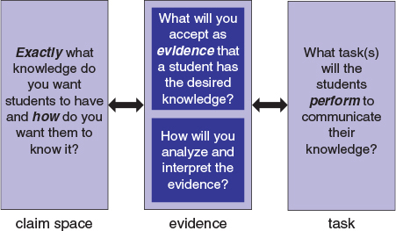
Analyze data systematically, either to look for salient patterns or to test whether data are consistent with an initial hypothesis (AI)
Given data, generate a plot/graph (with axes, labels and units) to illustrate patterns
Task Prompts
Key elements
(from Framework & NGSS)
Evidence Statement
Set of Related Prompts
Mislevy, R.; Haertel, G. (2006). Educ. Meas. Issues Pract. , 33, 379-416.

Slide 27
“The power of assessment to reveal and support learning depends on how well student responses to tasks authentically reflect their thinking and understanding.”
Kang, H., Thompson, J., & Windschitl, M. (2014). Science Education, 98(4), 674-704.

Slide 28
Analyzing Student Responses
Evidence Statements
Target Responses
Task Assessment Rubric
Students’ Responses

Slide 29
Based on the data and your calculation, what happened to the mass of the substance in the crucible when it was burned in air?
Its mass increased.
Its mass decreased.
Its mass was unchanged.
My calculations
support the phlogiston theory
refute the phlogiston theory
My calculations
support the phlogiston theory because…
refute the phlogiston theory because …
Phlogiston theory is an early theory to explain combustion (i.e. what happens when substances burn). In brief, the theory states that all combustible materials contain a substance called phlogiston, and when these materials burn, the phlogiston is released into the air.
A group of students carried out an experiment to investigate what happens when a combustible substance is burnt in air in a crucible (heat-resistant dish).
If phlogiston theory is valid (true), predict what will happen to the mass of the substance in the crucible when it is burnt in air.
Its mass will increase
Its mass will decrease
Its mass will remain unchanged
because….
phlogiston is added
phlogiston is released
matter cannot be created or destroyed
 | Mass (g)
Mass empty crucible | 15.5
Mass combustible substance before burning | 1.0
Mass crucible + combustible substance after burning | 17.0
Show the calculations you performed on the data to obtain evidence about what happened to the mass of the combustible substance after burning.

Slide 30
An explanation, conclusion, generalization to a research question
supported by
Evidence: based on data, observation, measurement, findings from other studies
justified by
Rationale: justifies the evidence through principles, concepts, models, assumptions
Sampson, V., Grooms, J., & Walker, J.P. (2011). Science Education, 95 (2), 217-257.

Slide 31
Trial #1: Methods
200 Total Participants
100 General Chemistry 1 (CLUE)
100 General Chemistry 2 (Traditional)
Inter-rater Reliability
5 raters, agreement 0.86-1.00

Slide 32
My calculations…
supports the phlogiston theory because
refutes the phlogiston theory because
Evidence Statement | Level 0 (illogical, incoherent, inconsistent) | Level 1 (Partially coherent) | Level 2 (Logical, coherent, consistent)
Explain (reason) how data /evidence support claim (EE) | Reasoning does not connect to either evidence/theory Reasoning connects to evidence/theory but inconsistent with initial claim | Reasoning connects to evidence OR theory, and consistent with initial claim | Reasoning connects to both evidence and theory and consistent with initial claim

Slide 33
My calculations…
supports the phlogiston theory because
refutes the phlogiston theory because
Significant Difference!
χ² =10.09, p<0.01, Cramer’s V=0.23 (sm.)

Slide 34
But…
Upon trying to replicate the results at full scale (~2500 responses), we couldn’t.
Institution 1:
Lecture: CLUE and Traditional
Laboratory: Project Based and Traditional
Institution 2:
Lecture: All CLUE
Laboratory: All Project Based

Slide 35
Effect of Context?
233 Total Participants
Responses on Phlogiston Task
Responses on Effusion Task
Uses an antiquated theory of combustion
No one teaches this…
More authentic chemistry context
Taught in many GenChem Courses

Slide 36
Effect of Context?
Significant Difference!
χ² =135.15, p<0.01, 𝛗=0.54 (lg.)

Slide 37
Effect of Context?
1725 Total Participants
Responses on Phlogiston Task
Responses on Magnesium Task
187 from 1st Semester
125 from 2nd Semester
192 from 1st Semester
125 from 2nd Semester

Slide 38
Effect of Context?
Significant Difference!
χ² = 49.05, p < 0.01, Cramer’s V = 0.25 (med.)

Slide 39
Effect of Context?
No Significant Difference!
χ² = 5.07, p = 0.079

Slide 40
Conclusions
Students are often given most opportunities to engage in practices early in the chemistry major.
Small, but meaningful, changes can be made to help increase engagement in the practices.
Assessment of laboratory outcomes is crucial!
Assessments need to be in a relevant context, focused not just on practices.

Slide 41
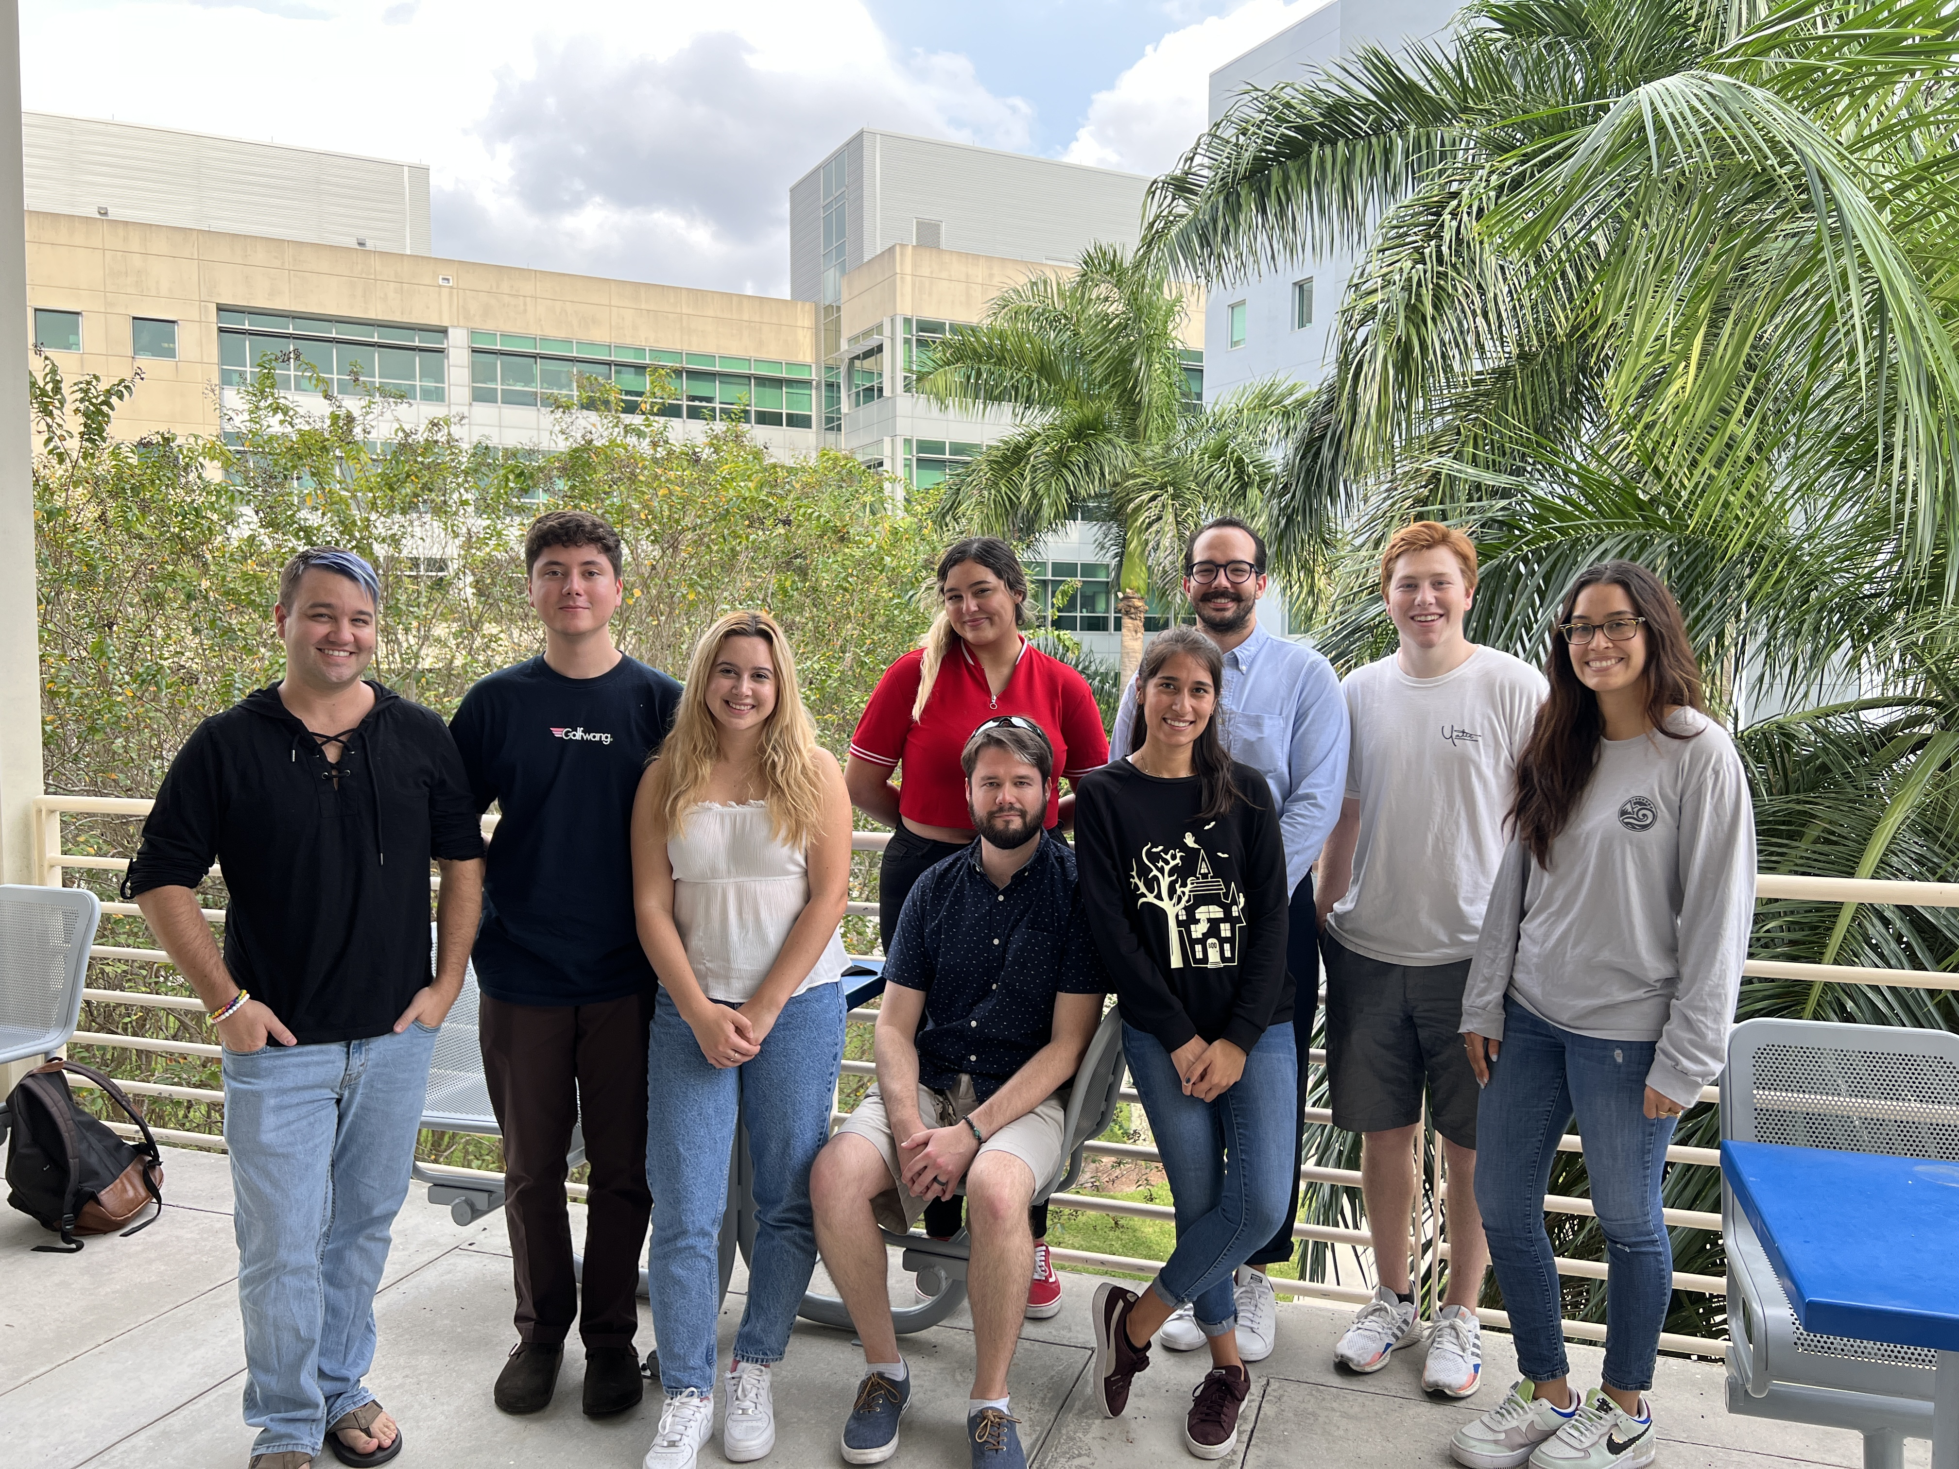
Ongoing Work
Implementation and Evaluation of a Project-based Organic Laboratory curriculum: Affecting students’ utility value?
NSF IUSE Grant: Collaborative Research: Development of Three-Dimensional Learning in General Chemistry Laboratory Environments (3DLab) #2236132, $599,350, submitted, PI: Carmel, J.H.; Co-PIs: Day, E.L.; Stephenson, N.S.

Slide 42

Acknowledgements
Project Team
Melanie Cooper (Michigan State, co-PI)
Deborah Herrington (Grand Valley, co-PI)
Norda Stephenson, Erin Duffy (Western Washington)
Elizabeth Day (UT El Paso)
Kira Padilla (Universidad Nacional Autónoma de México)
Student Participants
Florida International University
National Science Foundation
(#1708506)
Carmel Research Group (l to r): Dr. Justin Carmel, George Rophail, Daniela Martinez Rioseco, Viviana Montalti, Jake Carrier, Grace Leon-Lozano, Edian Villar, Trent Keeler, Giselle Castano (not pictured: Ingrid Lopez, Amy Rios)

Slide 43



Questions?
jcarmel@fiu.edu
@bluehairedchmst

