Slide 1
Animating Mathematical Concepts
(...and the learning of teachers, students, and researchers)

Slide 2
Our local teaching-research team
Tina, Kathleen, Katerin, Sofía, Melvin, and Higinio
Our extended teaching-research-friendship family:
New Mexico (Helena, Joaquín, and Carlos)
Virginia (Gladys, working with one teacher and newcomer students)

Slide 3
Our context (and what we do)
One elementary school (where we feel loved), Lansing School District
Grades 3, 4, 5, & 6
2 Animated Concept Studies per school year
1 Math Summer Camp per school year
Concept Study (Davis, 2008) borrows from Lesson Study (Fernandez & Yoshida, 2004) and Concept Analysis (Leinhardt, Putnam, & Hattrup, 1992)
Our Animated Concept Studies are full of vitality, animation, art, philosophy, bilingualism, and mucha felicidad.
Our Animated Concept Studies draw from concepts of intra-activity in Materialist Feminism (Barad, 2007; de Freitas & Sinclair, 2014), animacy and reciprocity in Indigenous Knowledges (Bell, 2013; Cajete, 2000; Little Bear, 2000) and decentering the human in Posthumanism (Bradiotti year; Deleuze & Guattari, 2004)

Slide 4
Day | Focus | Activity | Why
1 | Philosophical discussion on “place” and “value”. How can philosophy help us teach and learn the concepts of “place” and “value”? | Ask students what they value and why. Discuss with potential focus on what “value” means to them. See if or how different people may value the same thing(s) but differently. Ask where they store/keep items they value most (their real items in real places). Discuss the importance of those places. Transition to asking them to organize some items in the classroom (e.g. Maybe bring pictures of different items that they value; your call). Discuss their system of organization (e.g., ask: Why did you put what where…). Raise awareness of arbitrary nature of ordering and valuing (subjective but meaningful). | Importance of getting to know more about how children make sense of value and place. (By “making sense” we mean involving the whole body).

Slide 5
Day | Focus | Activity | Why
4 | How space is organized by different number systems. | Ask students if they can think about something that grows from right to left (horizontally). Confront them with how our base-10 system indicates growth from right to left. Study with them Mayan base-20 system. In pairs they take turns to write numbers given to them in base ten and in Mayan. Discuss differences they notice across two systems (guide conversation to space used vertically in Mayan and base-10 horizontally. Ask them to come up with many meanings for zero. Discuss common meaning of zero as “nothing” or “emptiness” is kind of static, compared to Mayan meaning as marking the beginning and end of one complete cycle. | Re-learn to see our base-10 system from a different perspective (embodied, place, lugar, direction).

Slide 6
Challenges to get project funded
Theories
“produce different knowledge and produce knowledge differently” (Lather 2007, p. 13).
Embracing our human uncertainty
Embracing mathematical indeterminacy
Embracing happiness and love for the possible
Is this “scientific” enough to be funded?!?!?! (one morning one student said: No, we’re not doing math).

Slide 7
Our plan for today’s talk
Share how the process of learning to animate mathematical concepts has impacted how we:
A) teach and learn
B) relate to others, human and more than human
C) re-encounter research (broadly)
D) re-encounter research on teacher learning (specifically)

Slide 8
Sharing how we learn together
Tina
Sofía
Melvin
Higinio

Slide 11
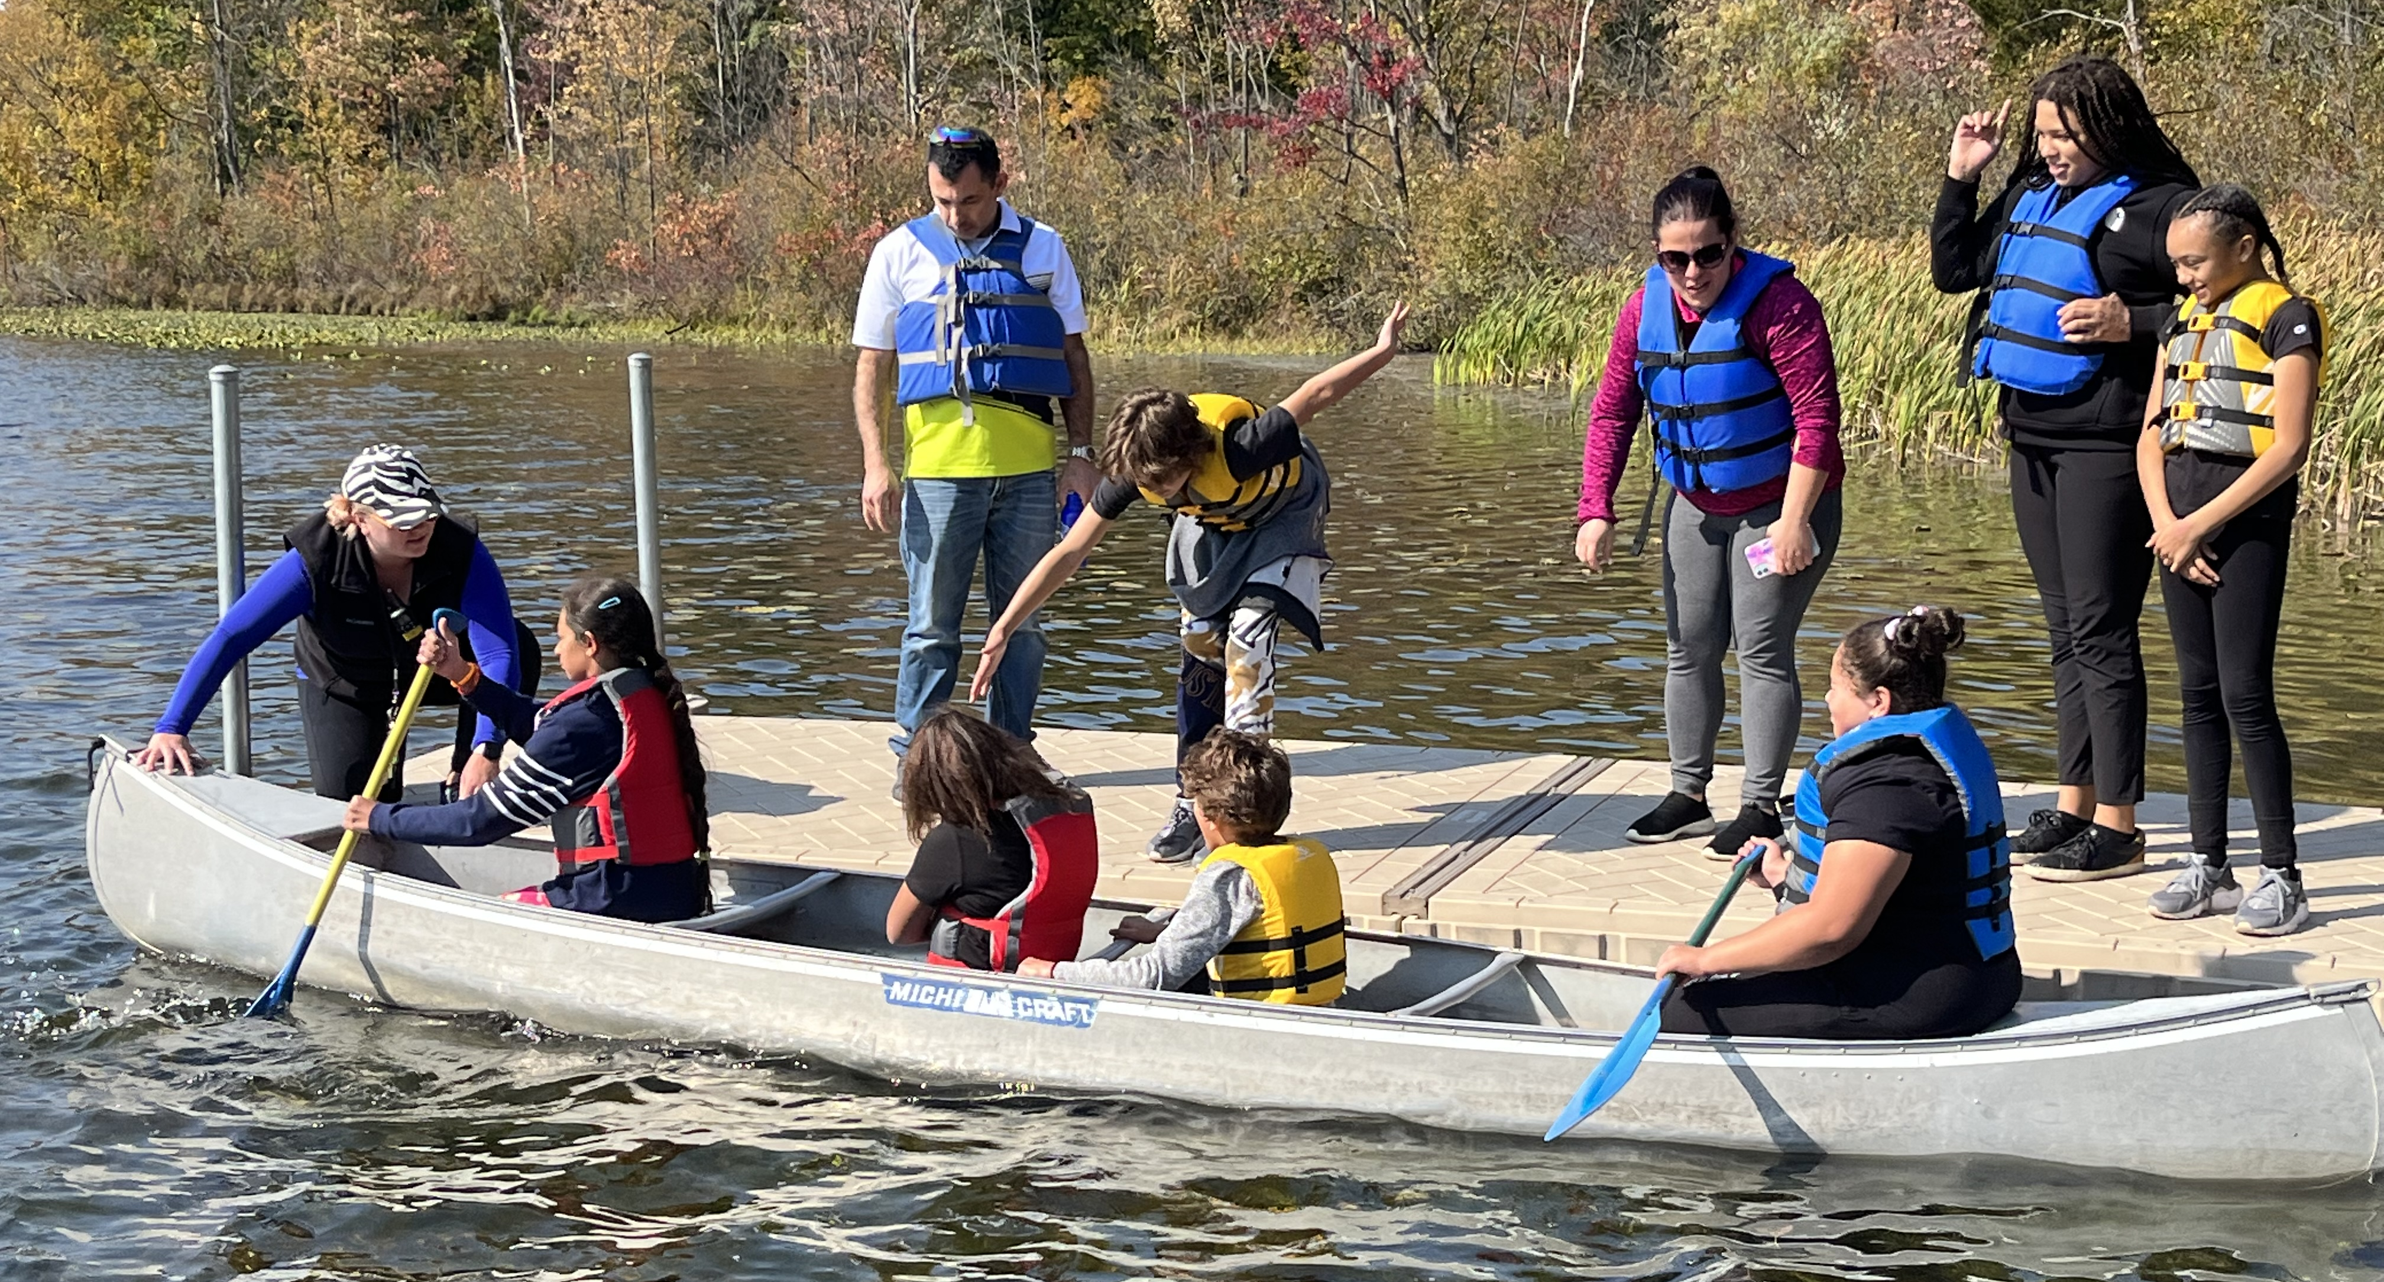

Slide 12
Math = Canoeing

Slide 13
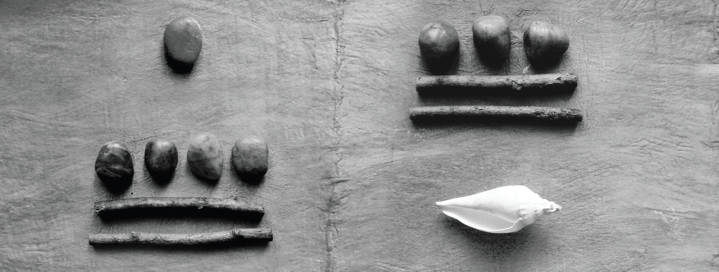

Slide 14
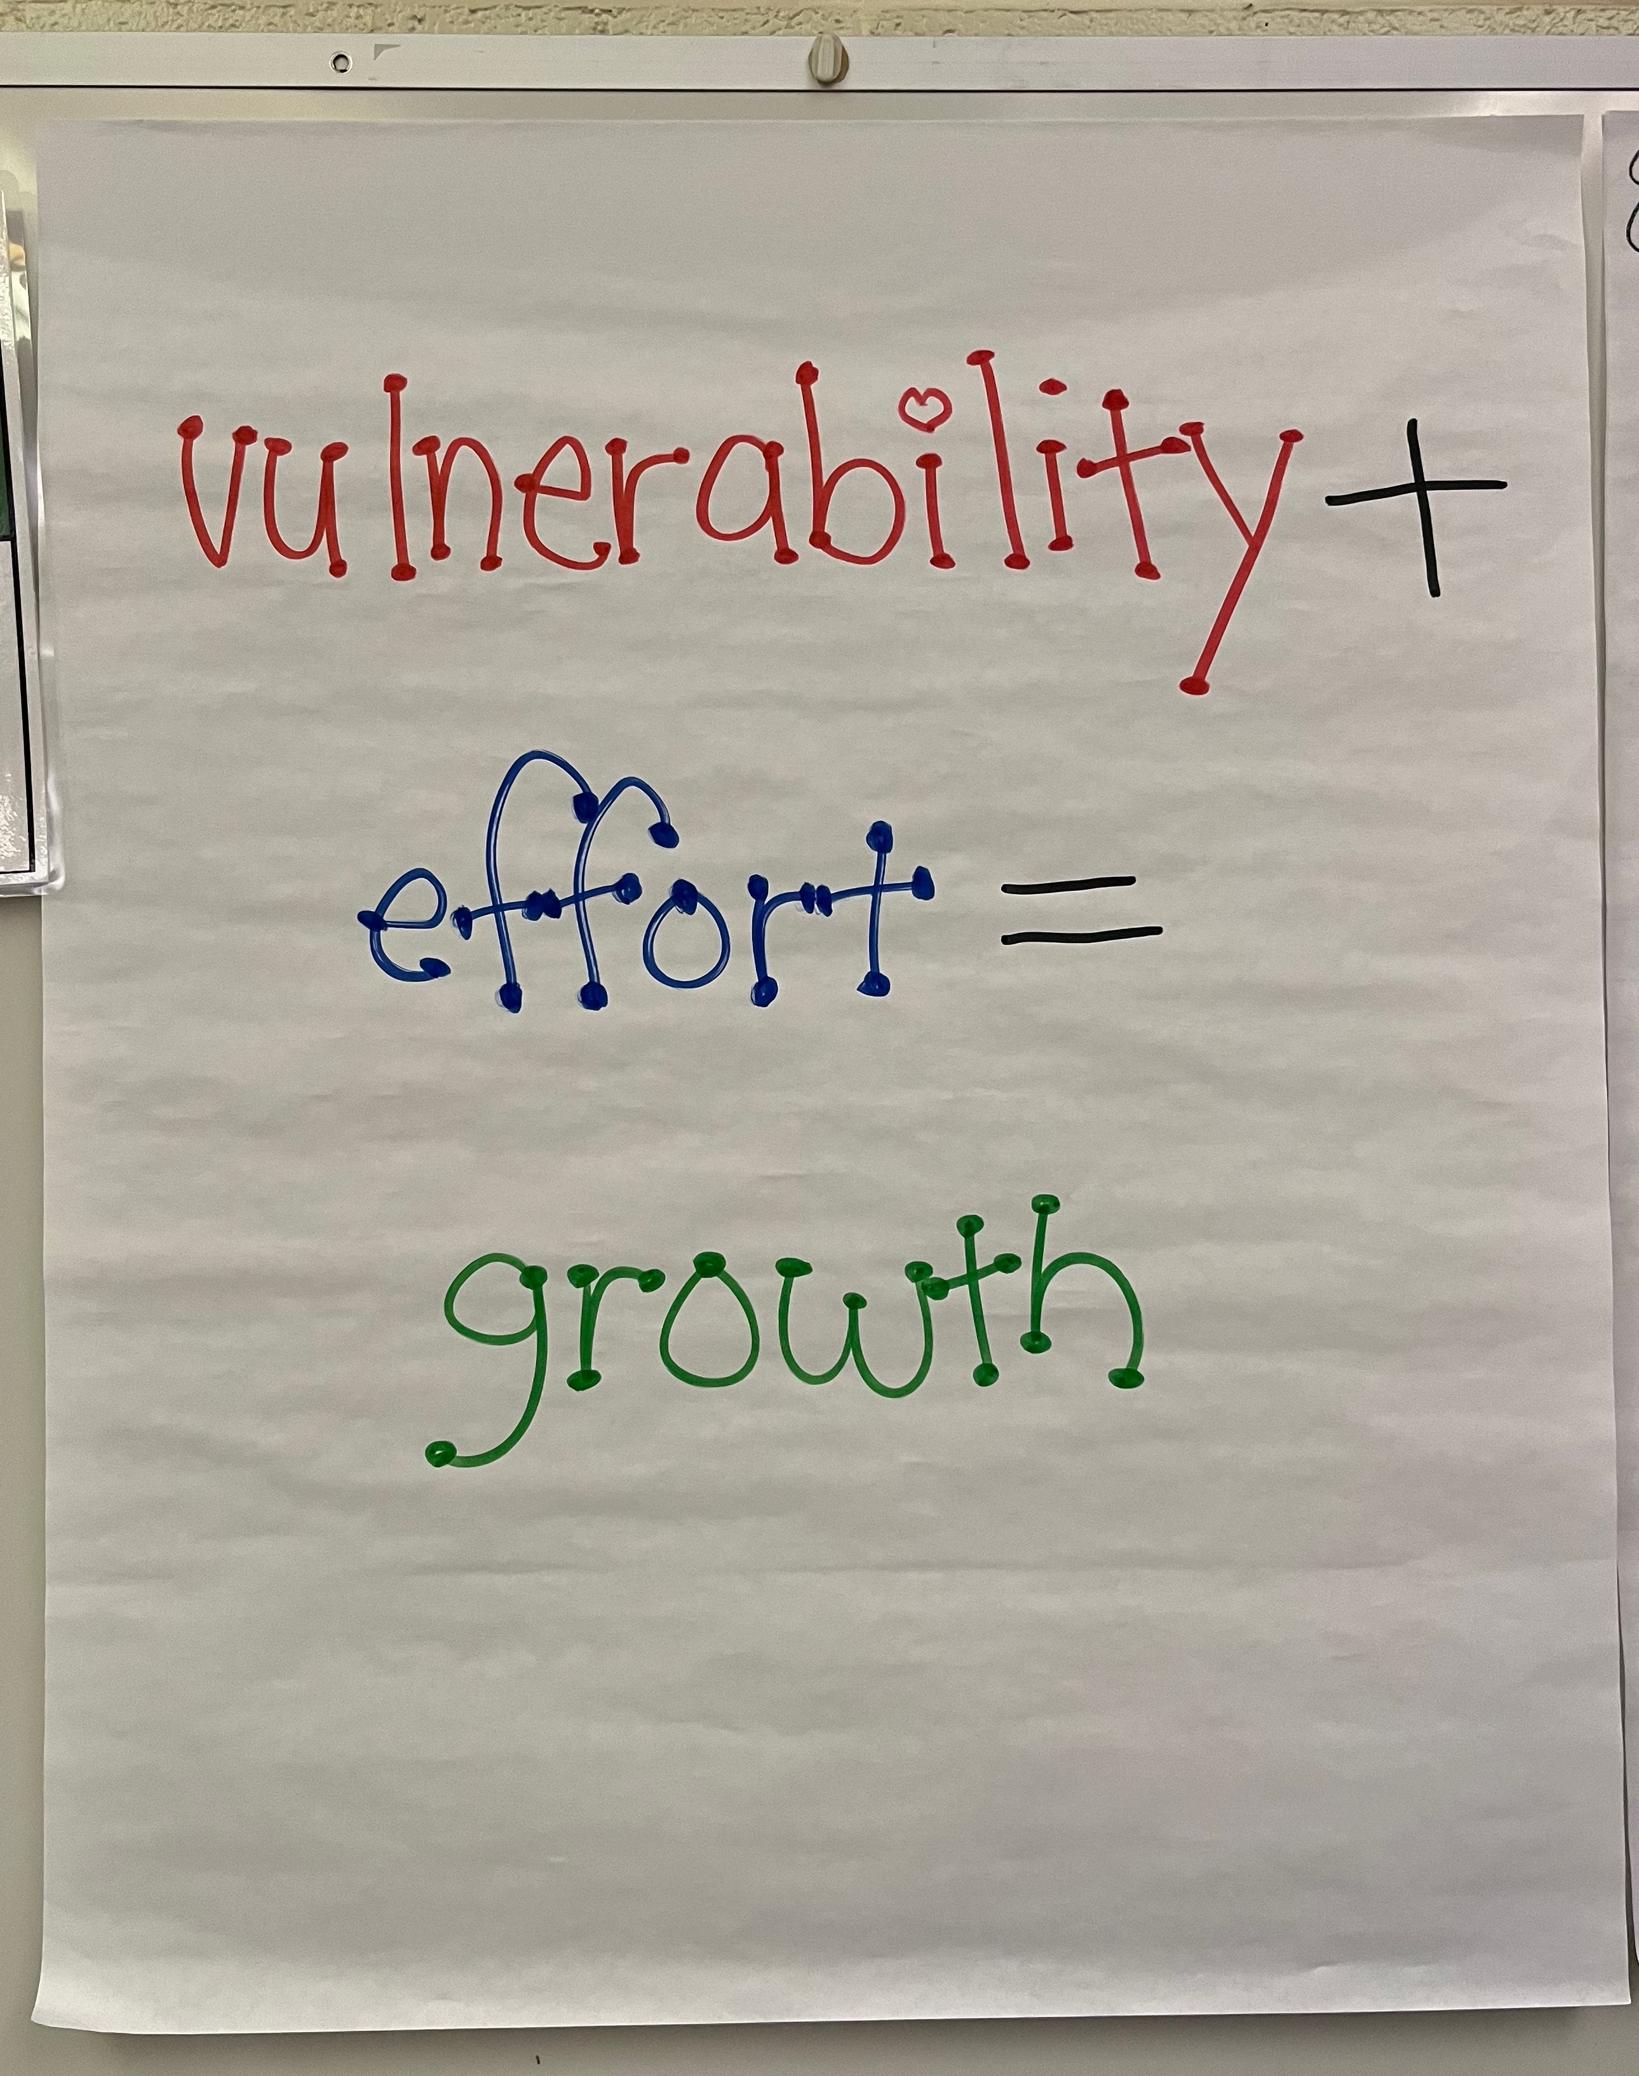
Notes:
Add vulnerability chart pic in here.

